Slide 1
W4111 – Introduction to Databases Section 002, Fall 2025 Lecture 3: Foundation – ER, Relational, SQL (2)
COMSW4111_002_2026_1- Foundation – ER, Relational, SQL (2) © Donald F. Ferguson, 2025

Slide 2
Contents

Slide 3
Notes and Content
ER Model/Modeling:
Generalization/Specialization
Aggregation
Relational algebra
Left Join, Right Join, Semi-Join
Division
SQL
Aggregation
Subquery review and continuation
Complex JOIN
Generalization/Specialization
Project concepts: (Web) applications, REST, data engineering

Slide 4
ER Model/ER Modeling

Slide 5
Complex Attributes

Slide 6
Complex Attributes
Attribute types:
Simple and composite attributes.
Single-valued and multivalued attributes
Example: multivalued attribute: phone_numbers
Derived attributes
Can be computed from other attributes
Example: age, given date_of_birth
Domain – the set of permitted values for each attribute

Slide 7
Composite Attributes
Composite attributes allow us to divided attributes into subparts (other attributes).

Slide 8
Representing Complex Attributes in ER Diagram
Swith to Lucidchart and show how to model. Show a couple of options/design choices.

Slide 9
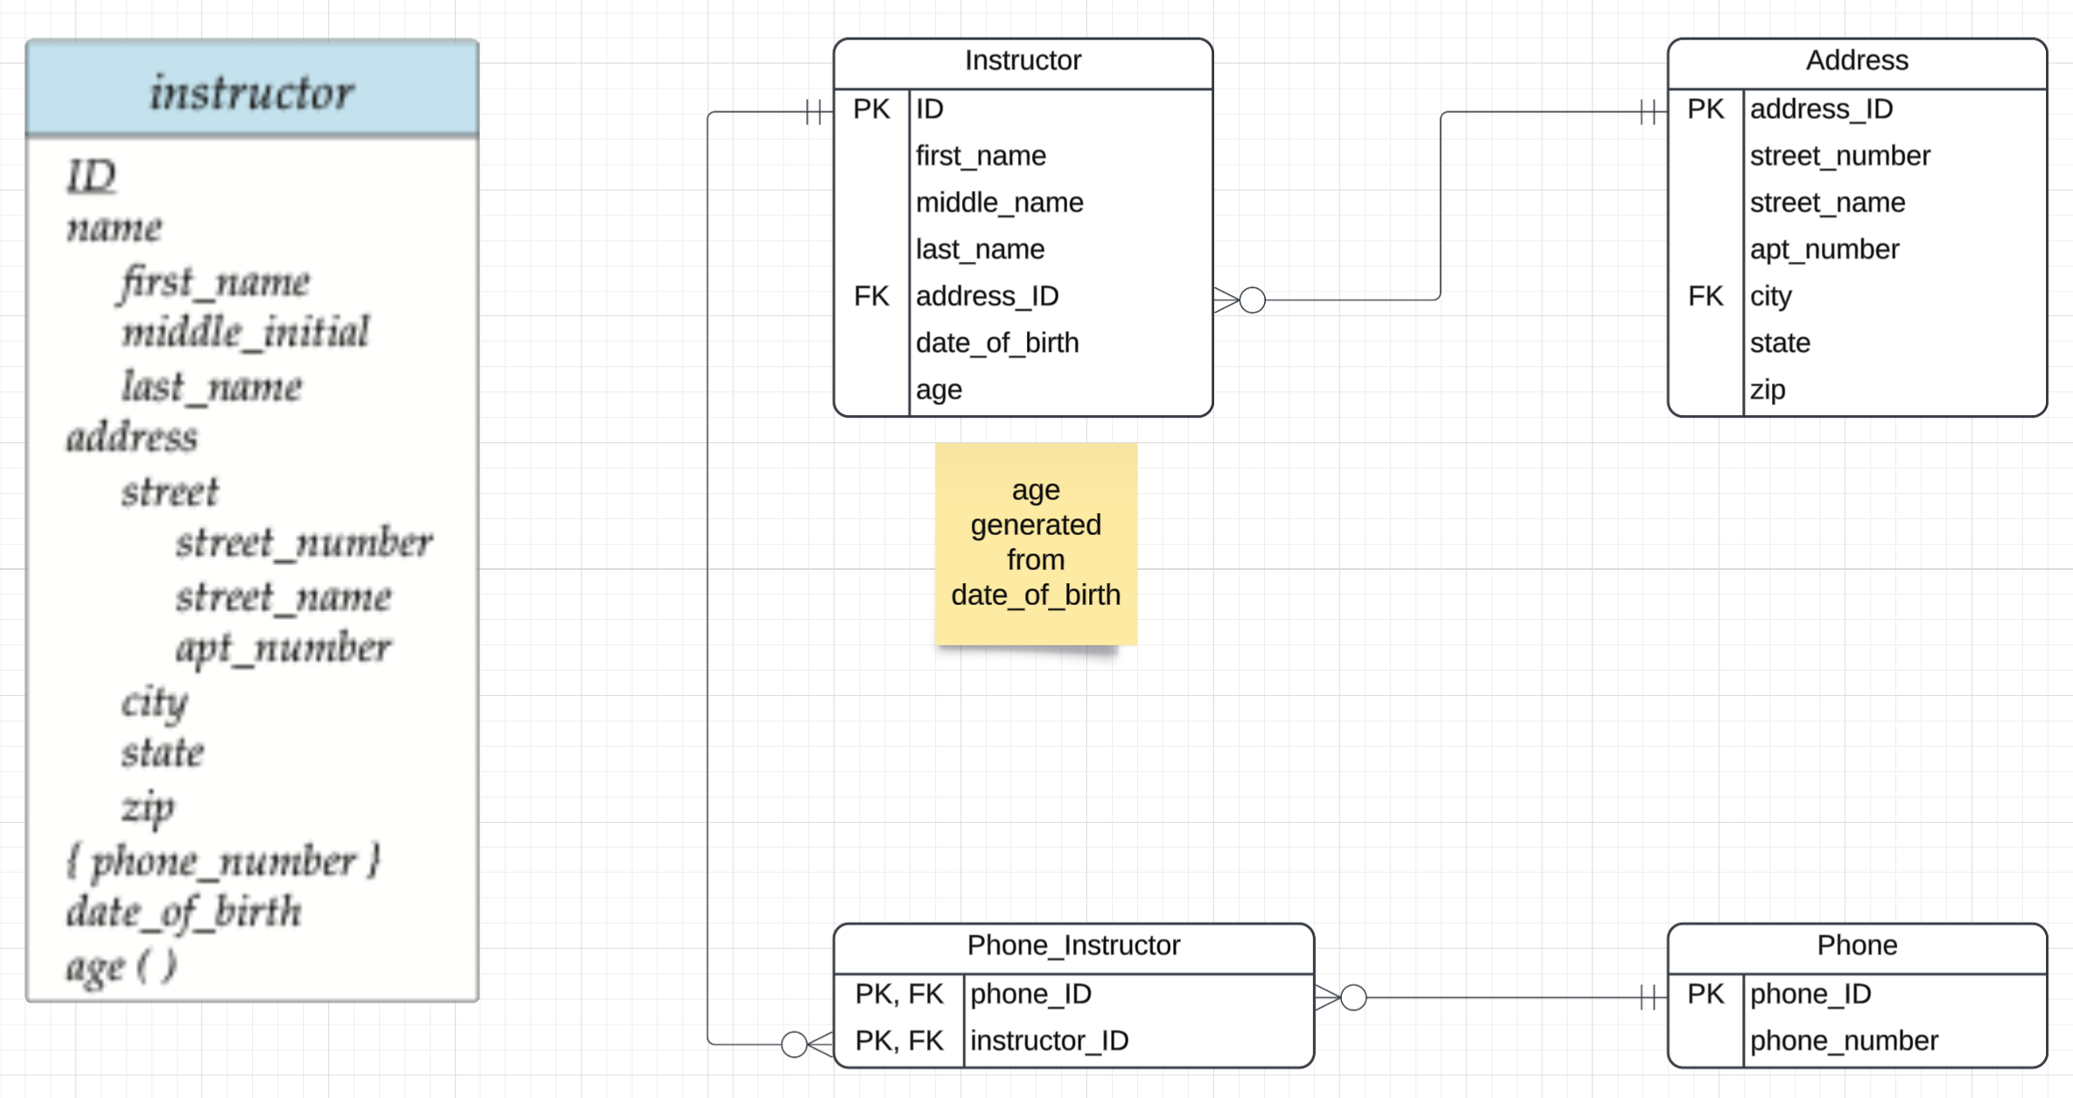
Complex Attributes in Crow’s Foot Notation
Like much ER modeling, there are design options and choices
Composite
Use a 2nd entity type and foreign key relationship.
“Explode” into individual attributes.
Multi-valued
Use a 2nd entity type with a foreign key or associative entity.
Note: I assume in my design that the relationship between instructor and phone was many-to-many. I would likely also add a “phone_type” property, e.g. home, mobile, … …
The only way to handle generated is with a note or annotation.

Slide 10
Switch to Notebook

Slide 11
Inheritance/Specialization/Generalization

Slide 12
Specialization
Top-down design process; we designate sub-groupings within an entity set that are distinctive from other entities in the set.
These sub-groupings become lower-level entity sets that have attributes or participate in relationships that do not apply to the higher-level entity set.
Depicted by a triangle component labeled ISA (e.g., instructor “is a” person).
Attribute inheritance – a lower-level entity set inherits all the attributes and relationship participation of the higher-level entity set to which it is linked.

Slide 13
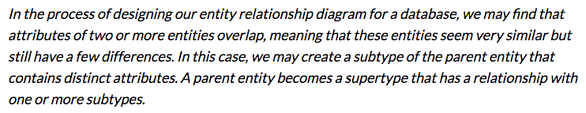
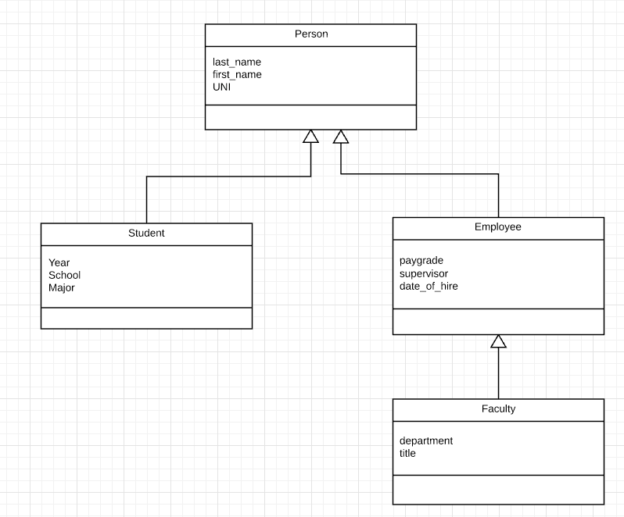
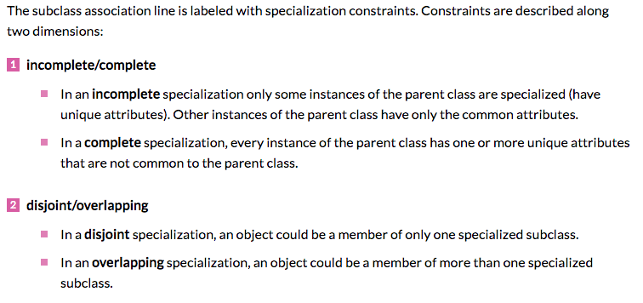
Inheritance/Specialization
Are all employees faculty?
Can students also be employees?
http://www.vertabelo.com/blog/technical-articles/inheritance-in-a-relational-database

Slide 14
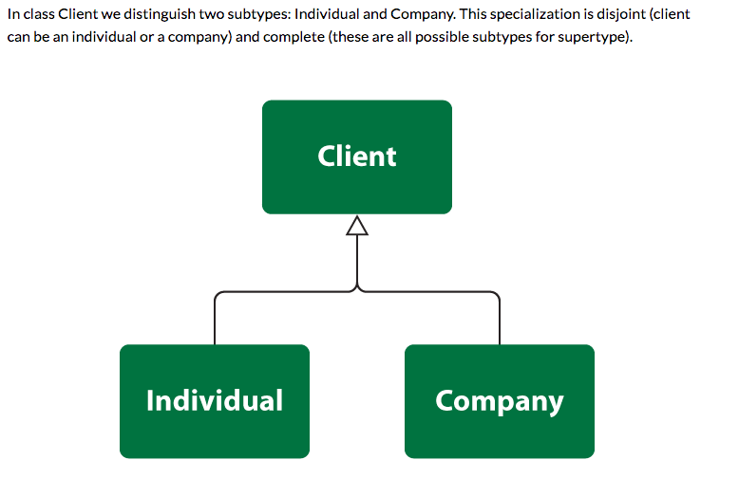
Specialization

Slide 15
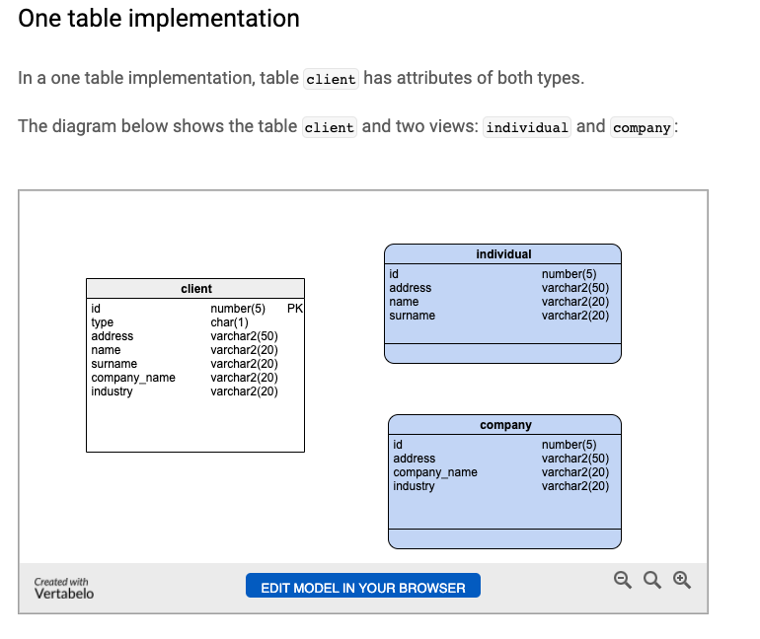
One Table
Views
Tables

Slide 16
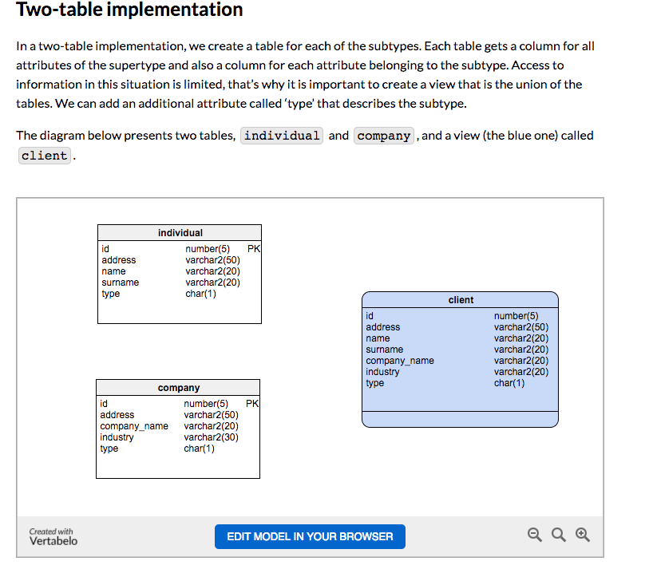
Two Table
View
Tables

Slide 17
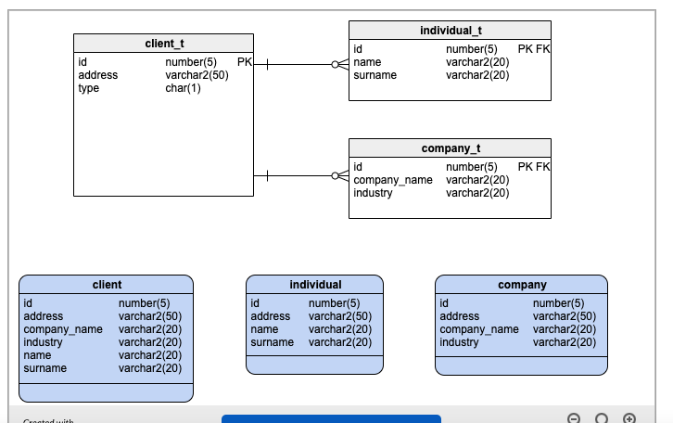
Three Table

Slide 18
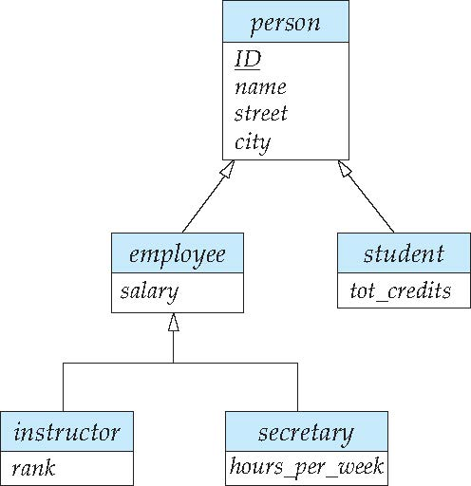
Specialization Example
Overlapping – employee and student
Disjoint – instructor and secretary
Total and partial

Slide 19
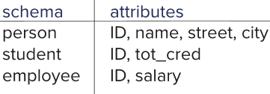
Representing Specialization via Schemas
Method 1:
Form a schema for the higher-level entity
Form a schema for each lower-level entity set, include primary key of higher-level entity set and local attributes
Drawback: getting information about, an employee requires accessing two relations, the one corresponding to the low-level schema and the one corresponding to the high-level schema
Notes:
19

Slide 20
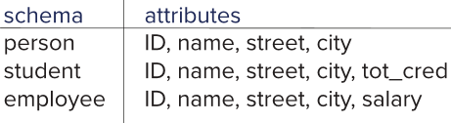
Representing Specialization as Schemas (Cont.)
Method 2:
Form a schema for each entity set with all local and inherited attributes
Drawback: name, street and city may be stored redundantly for people who are both students and employees
Notes:
20

Slide 21
Generalization
A bottom-up design process – combine a number of entity sets that share the same features into a higher-level entity set.
Specialization and generalization are simple inversions of each other; they are represented in an E-R diagram in the same way.
The terms specialization and generalization are used interchangeably.

Slide 22
Completeness constraint
Completeness constraint -- specifies whether or not an entity in the higher-level entity set must belong to at least one of the lower-level entity sets within a generalization.
total: an entity must belong to one of the lower-level entity sets
partial: an entity need not belong to one of the lower-level entity sets

Slide 23
Completeness constraint (Cont.)
Partial generalization is the default.
We can specify total generalization in an ER diagram by adding the keyword total in the diagram and drawing a dashed line from the keyword to the corresponding hollow arrow-head to which it applies (for a total generalization), or to the set of hollow arrow-heads to which it applies (for an overlapping generalization).
The student generalization is total: All student entities must be either graduate or undergraduate. Because the higher-level entity set arrived at through generalization is generally composed of only those entities in the lower-level entity sets, the completeness constraint for a generalized higher-level entity set is usually total

Slide 24
Relational Algebra

Slide 25
What are all those other Symbols?
Some of the operators are useful and “common,” but not always considered part of the core algebra.
Some of these are pretty obscure
Division
Anti-Join
Left semi-join
Right semi-join
Most SQL engines do not support them.
You can implement them using combinations of JOIN, SELECT, WHERE, ... ...
But, I cannot every remember using them in applications I have developed.
Outer JOIN is very useful, but less common. We will cover.
There are also some “patterns” or “terms”
Equijoin
Non-equi join
Natural join
Theta join
... ...
I may ask you to define these terms on some exams or the obscure operatorsbecause they may be common internships/job interview questions.
τ order by
γ group by
¬ negation
÷ set division
⨝ natural join, theta-join
⟕ left outer join
⟖ right outer join
⟗ full outer join
⋉ left semi join
⋊ right semi join
▷ anti-join

Slide 26
Thinking about JOINs
Some terms:
Natural Join
Equality of A and B columns
With the same name.
Equijoin
Explicitly specify columns that must have the same value.
A.x=B.z AND A.q=B.w
Theta Join: Arbitrary predicate.
Inner Join
JOIN “matches” rows in A and B.
Result contains ONLY the matched pairs.
What I want is:
All the rows that matched.
And the rows from A that did not match?
OUTER JOIN (⟖, ⟕)

Slide 27
OUTER JOIN
“An outer join is an operation that combines rows from two or more tables, returning all records from the tables based on a join condition, including unmatched rows filled with NULL values. Unlike inner joins that require matches, outer joins preserve data from one or both tables, making them essential for auditing, comparing datasets, and finding missing information.”
There are
LEFT OUTER JOIN
RIGHT OUTER JOIN
FULL OUTER JOIN
Consider
instructor ⨝ ID=i_id advisor versus
instructor ⟕ ID=i_id advisor
Which instructors do not advise any student? σ s_id=null (instructor ⟕ ID=i_id advisor)

Slide 28
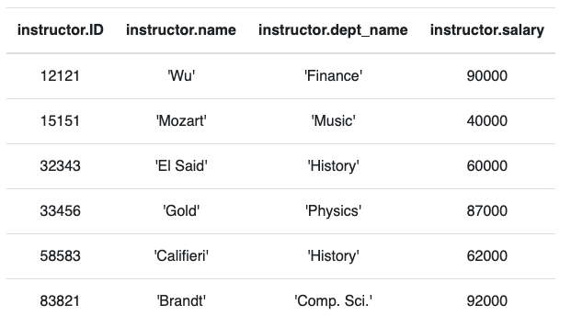
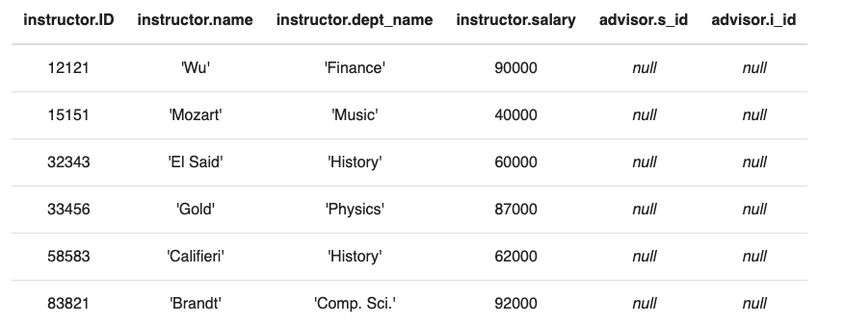
Anti – Join
“An anti-join is when you would like to keep all of the records in the original table except those records that match the other table.”
instructor ▷ ID=i_id advisor
σ i_id=null (instructor ⟕ ID=i_id advisor)

Slide 29
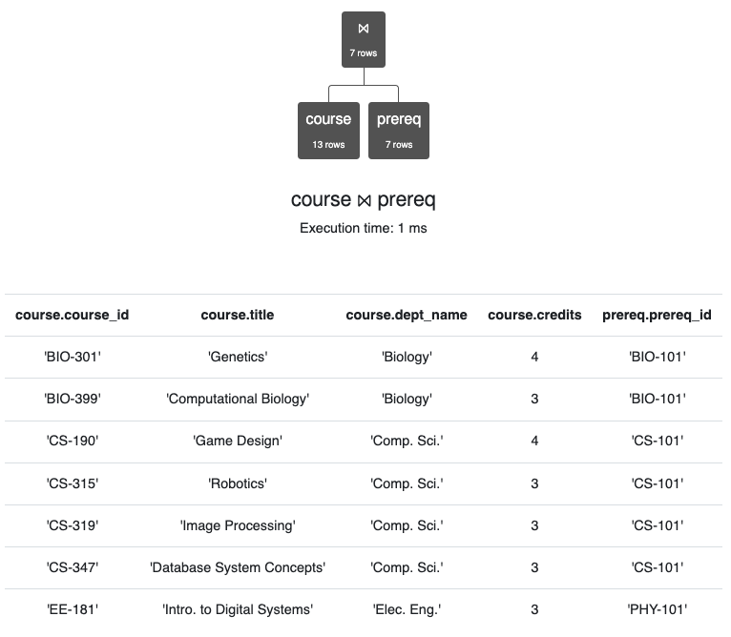
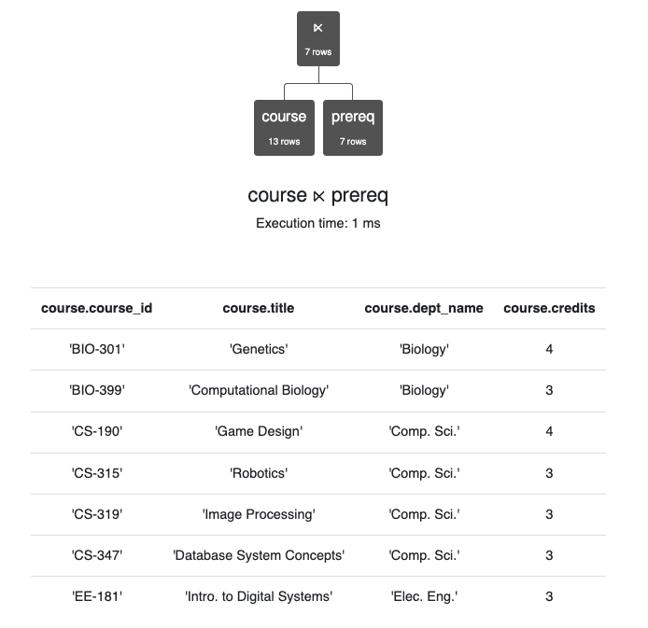
Semi-Join
Semi-join is a type of join that is applied to relations to join them based on the related columns. When semi-join is applied, it returns the rows from one table for which there are matching records in another related table.

Slide 30
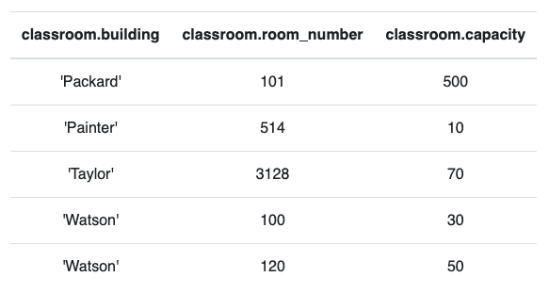
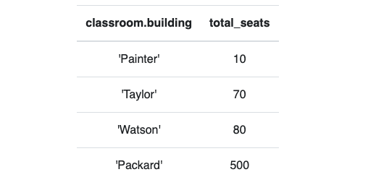
Group By, Order By
classroom
These are very simple examples.
We can apply them to relations created by operations on other tables.
τ total_seats (γ building; sum(capacity)→total_seats (classroom))

Slide 31
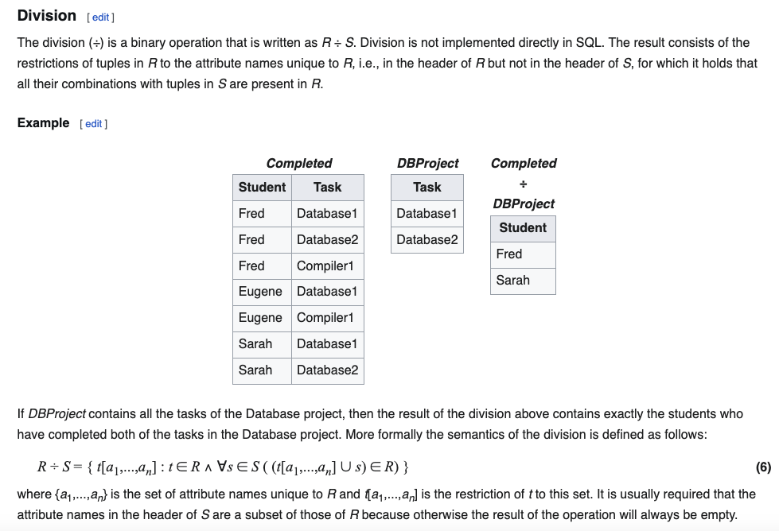
Division
Relax Example
X = π course_id←course_id (σ dept_name='History' (course))
Y = π ID←ID, course_id←course_id (student ⨝ takes)
Y ÷ X

Slide 32
Relational Databases/SQL

Slide 33
Aggregate Functions

Slide 34
Aggregate Functions
These functions operate on the multiset of values of a column of a relation, and return a value
avg: average value min: minimum value max: maximum value sum: sum of values count: number of values
Note: Some database implementations have additional aggregate functions.

Slide 35
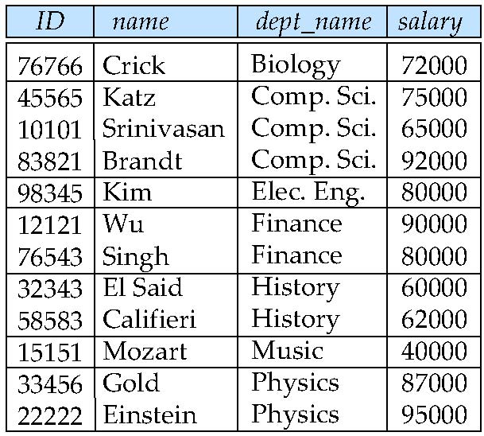
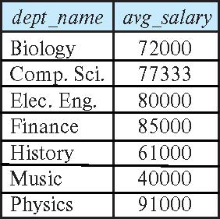
Aggregate Functions – Group By
Find the average salary of instructors in each department
select dept_name, avg (salary) as avg_salary from instructor group by dept_name;

Slide 36
Another View
GROUP BY column list
Forms partitions containing multiple rows.
All rows in a partition have the same values for the GROUP BY columns.
The aggregate functions
Merge the non-group by attributes, which may differ from row to row.
Into a single value for each attribute.
The result is one row per distinct set of GROUP BY values.
There may be multiple non-GROUP BY COLUMNS, each with its own aggregate function.
You can use HAVING in place of WHERE on the GROUP BY result.

Slide 37
Aggregate Functions Examples
Find the average salary of instructors in the Computer Science department
select avg (salary) from instructor where dept_name= 'Comp. Sci.';
Find the total number of instructors who teach a course in the Spring 2018 semester
select count (distinct ID) from teaches where semester = 'Spring' and year = 2018;
Find the number of tuples in the course relation
select count (*) from course;

Slide 38
Aggregation (Cont.)
Attributes in select clause outside of aggregate functions must appear in group by list
/* erroneous query */ select dept_name, ID, avg (salary) from instructor group by dept_name;

Slide 39
Aggregate Functions – Having Clause
Find the names and average salaries of all departments whose average salary is greater than 42000
Note: predicates in the having clause are applied after the formation of groups whereas predicates in the where clause are applied before forming groups
Select …. From …. Where … … group by … …. Having … …
select dept_name, avg (salary) as avg_salary
from instructor where dept_name in (‘Biology’, ‘Physics’, ‘Comp.Sci.’)
group by dept_name
having avg (salary) > 42000;

Slide 40
Switch to Notebook

Slide 41
More Function with JOIN

Slide 42
Outer Join
An extension of the join operation that avoids loss of information.
Computes the join and then adds tuples form one relation that does not match tuples in the other relation to the result of the join.
Uses null values.
Three forms of outer join:
left outer join
right outer join
full outer join

Slide 43
One Way to Think About Joins

Slide 44
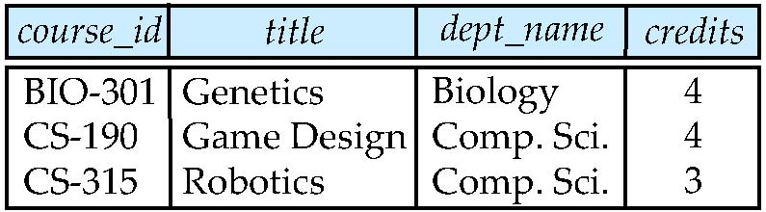
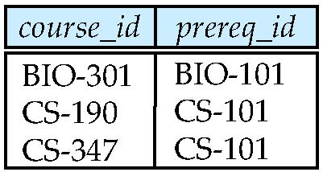
Outer Join Examples
Relation course
Relation prereq
Observe that
course information is missing CS-437
prereq information is missing CS-315
x

Slide 45
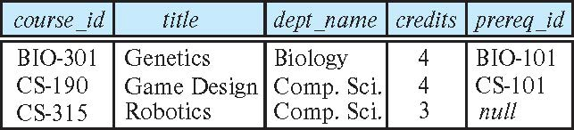
Left Outer Join
course natural left outer join prereq
In relational algebra: course ⟕ prereq

Slide 46
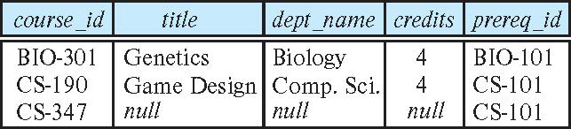
Right Outer Join
course natural right outer join prereq
In relational algebra: course ⟖ prereq

Slide 47
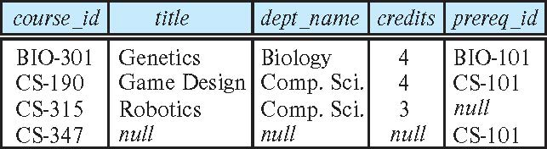
Full Outer Join
course natural full outer join prereq
In relational algebra: course ⟗ prereq

Slide 48
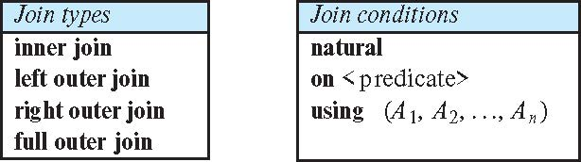
Joined Types and Conditions
Join operations take two relations and return as a result another relation.
These additional operations are typically used as subquery expressions in the from clause
Join condition – defines which tuples in the two relations match.
Join type – defines how tuples in each relation that do not match any tuple in the other relation (based on the join condition) are treated.

Slide 49
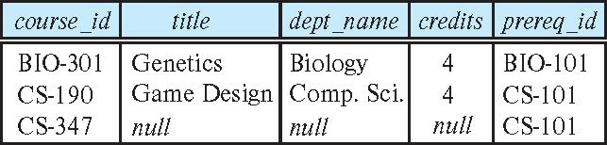
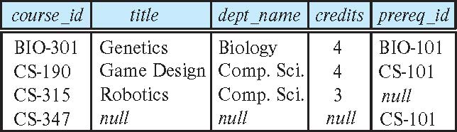
Joined Relations – Examples
course natural right outer join prereq
course full outer join prereq using (course_id)

Slide 50
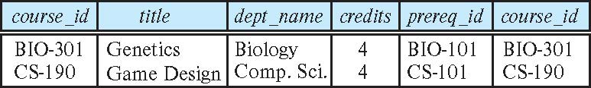
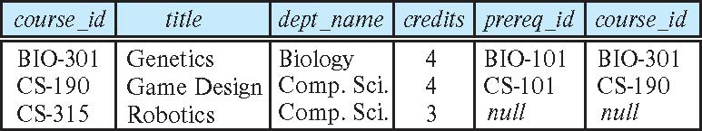
Joined Relations – Examples
course inner join prereq on course.course_id = prereq.course_id
What is the difference between the above, and a natural join?
course left outer join prereq on course.course_id = prereq.course_id

Slide 51
Joined Relations – Examples
course natural right outer join prereq
course full outer join prereq using (course_id)

Slide 52
Switch to Notebook

Slide 53

Codd’s 12 Rules
53 | COMS W4111_002_2025_1 - Lecture 6: ER(5), Relational(5), SQL(5) © Donald F. Ferguson, 2025

Slide 54
Overview

Slide 55

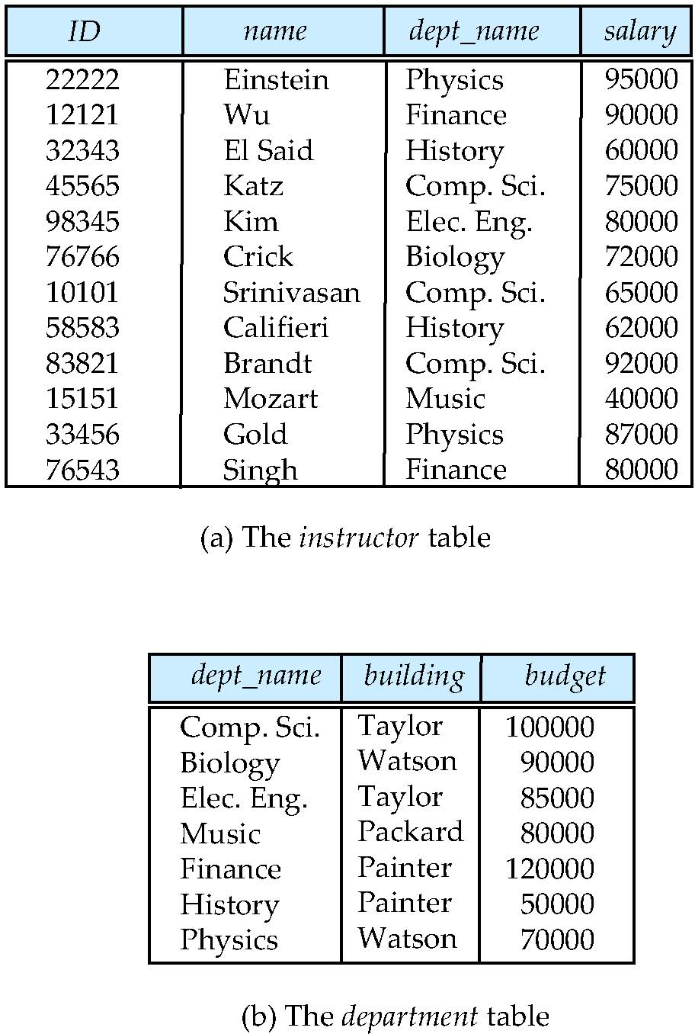
Relational Model
All the data is stored in various tables.
Example of tabular data in the relational model
Columns
Ted Codd Turing Award 1981
Rows
Notes:
55

Slide 56
Codd’s 12 Rules
Rule 1: Information Rule
The data stored in a database, may it be user data or metadata, must be a value of some table cell. Everything in a database must be stored in a table format.
Rule 2: Guaranteed Access Rule
Every single data element (value) is guaranteed to be accessible logically with a combination of table-name, primary-key (row value), and attribute-name (column value). No other means, such as pointers, can be used to access data.
Rule 3: Systematic Treatment of NULL Values
The NULL values in a database must be given a systematic and uniform treatment. This is a very important rule because a NULL can be interpreted as one the following − data is missing, data is not known, or data is not applicable.
Rule 4: Active Online Catalog
The structure description of the entire database must be stored in an online catalog, known as data dictionary, which can be accessed by authorized users. Users can use the same query language to access the catalog which they use to access the database itself.
Rule 5: Comprehensive Data Sub-Language Rule
A database can only be accessed using a language having linear syntax that supports data definition, data manipulation, and transaction management operations. This language can be used directly or by means of some application. If the database allows access to data without any help of this language, then it is considered as a violation.
Rule 6: View Updating Rule
All the views of a database, which can theoretically be updated, must also be updatable by the system.

Slide 57
Codd’s 12 Rules
Rule 7: High-Level Insert, Update, and Delete Rule
A database must support high-level insertion, updation, and deletion. This must not be limited to a single row, that is, it must also support union, intersection and minus operations to yield sets of data records.
Rule 8: Physical Data Independence
The data stored in a database must be independent of the applications that access the database. Any change in the physical structure of a database must not have any impact on how the data is being accessed by external applications.
Rule 9: Logical Data Independence
The logical data in a database must be independent of its user’s view (application). Any change in logical data must not affect the applications using it. For example, if two tables are merged or one is split into two different tables, there should be no impact or change on the user application. This is one of the most difficult rule to apply.
Rule 10: Integrity Independence
A database must be independent of the application that uses it. All its integrity constraints can be independently modified without the need of any change in the application. This rule makes a database independent of the front-end application and its interface.
Rule 11: Distribution Independence
The end-user must not be able to see that the data is distributed over various locations. Users should always get the impression that the data is located at one site only. This rule has been regarded as the foundation of distributed database systems.
Rule 12: Non-Subversion Rule
If a system has an interface that provides access to low-level records, then the interface must not be able to subvert the system and bypass security and integrity constraints.

Slide 58
Rule 1: Information Rule The data stored in a database, may it be user data or metadata, must be a value of some table cell. Everything in a database must be stored in a table format.
Rule 4: Active Online Catalog
The structure description of the entire database must be stored in an online catalog, known as data dictionary, which can be accessed by authorized users. Users can use the same query language to access the catalog which they use to access the database itself.

Slide 59
Rule 1 – Information Rule
Rule 1: Information Rule – The data stored in a database, may it be user data or metadata, must be a value of some table cell. Everything in a database must be stored in a table format.
We have seen that all user application data is stored in tables. We will see metadata in a minute through the online catalog.
What other data is there? Every database implementation handles this differently.
MySQL has 3 schemas/databases that you have seen but not examine.
information_schema (is the catalog, which we will discuss in a minute).
sys
mysql
That contain a mix of metadata, security information, configuration and performance data, … …
Show the schema in DataGrip.

Slide 60
Some Interesting Queries
sys
select * from sys.sys_config;
select * from sys.host_summary;
select * from sys.session;
select * from sys.user_summary;
mysql
select * from mysql.help_topic;
select * from mysql.user;
select * from mysql.default_roles;
select * from mysql.innodb_table_stats;
Most of this is pretty obscure, and all empty/incomplete in a single server, free version of MySQL.

Slide 61
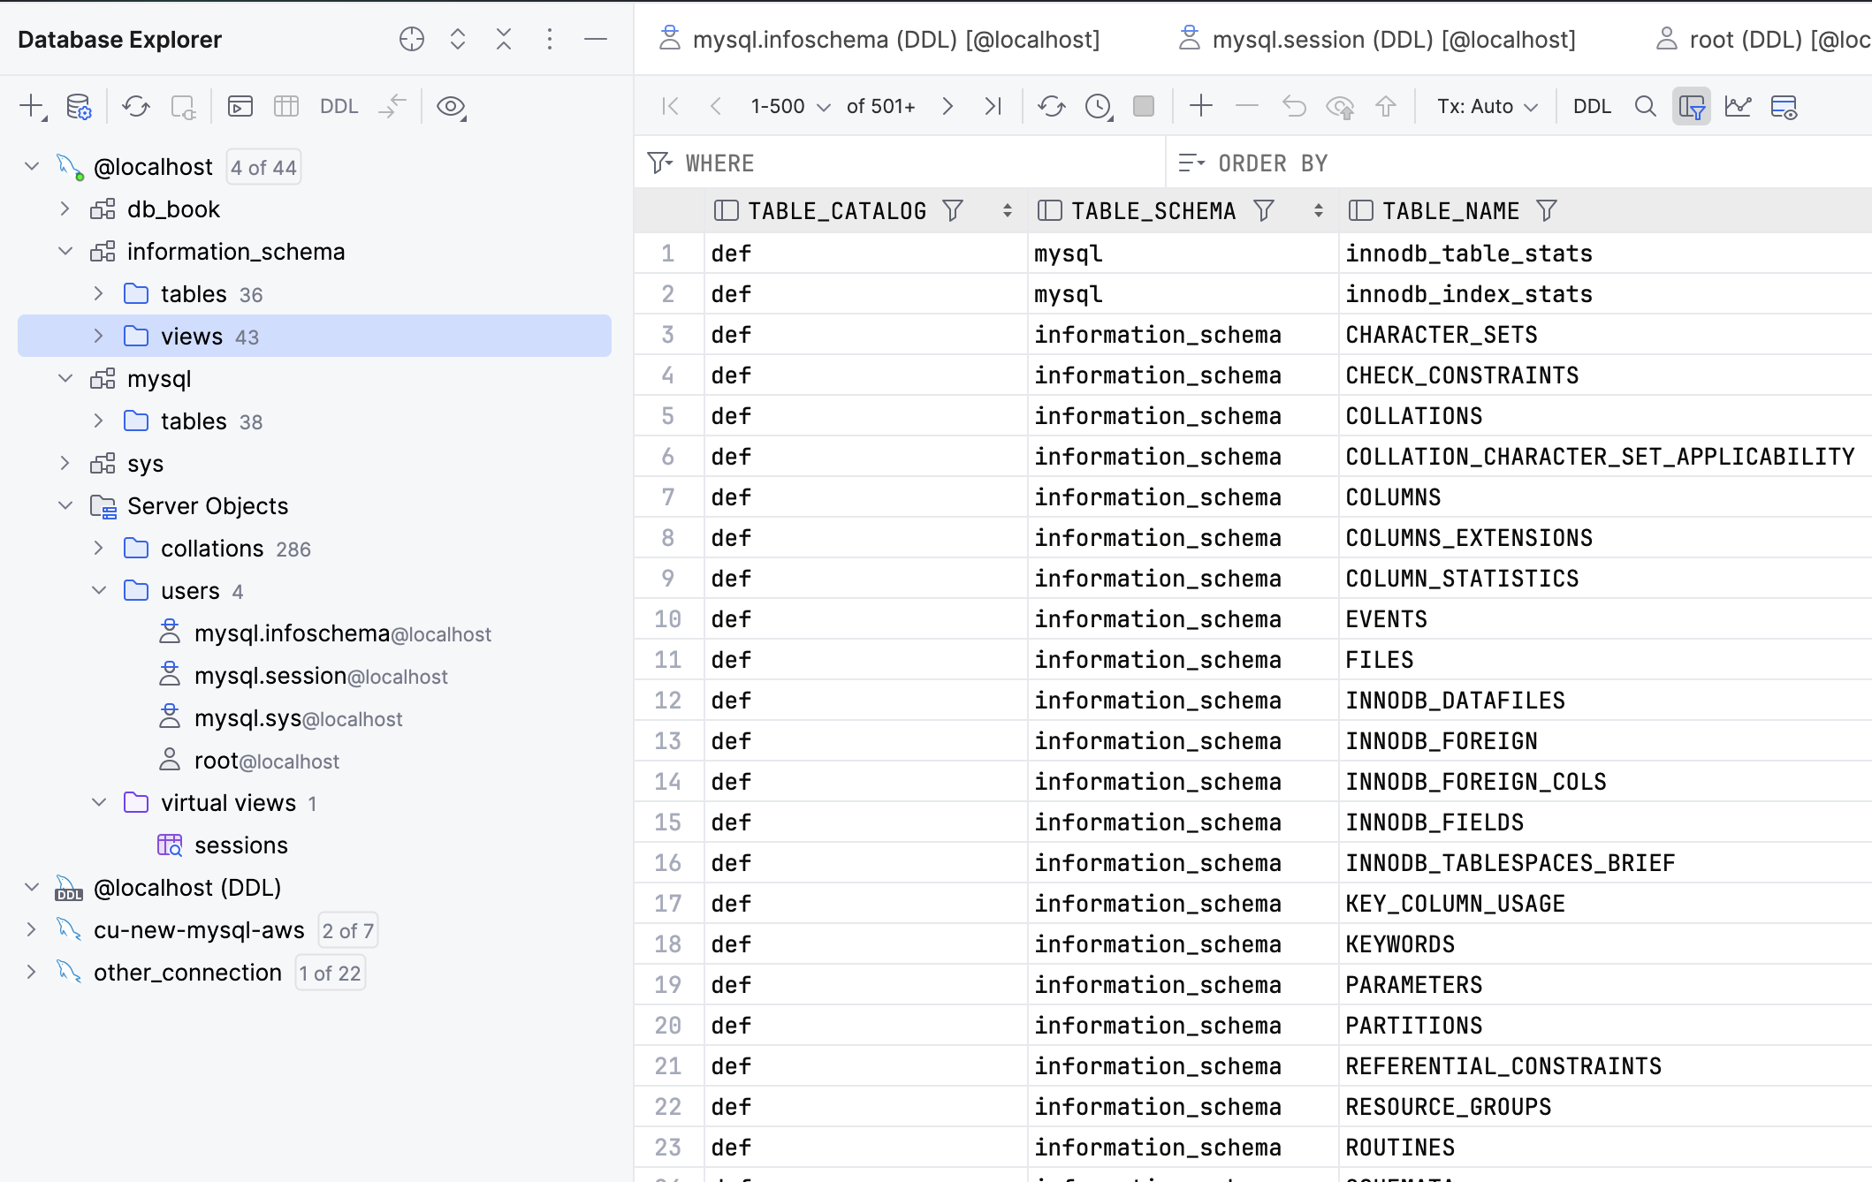
Metadata and System Tables
db_book is a schema that holds “data.”
information_schema is the “online catalog” and holds information about schemas, tables, columns, keys, indexes, ……
mysql: “The mysql schema is the system schema. It contains tables that store information required by the MySQL server as it runs. … (https://dev.mysql.com/doc/refman/8.4/en/system-schema.html)
sys: “MySQL 8.4 includes the sys schema, a set of objects that helps DBAs and developers interpret data collected by the Performance Schema.” (https://dev.mysql.com/doc/refman/8.4/en/sys-schema.html)
Server Objects contains information about sessions, collations, … …

Slide 62
Data Definition Language (DDL)
Specification notation for defining the database schema
Example: create table instructor ( ID char(5), name varchar(20), dept_name varchar(20), salary numeric(8,2))
DDL compiler generates a set of table templates stored in a data dictionary
Data dictionary contains metadata (i.e., data about data)
Database schema
Integrity constraints
Primary key (ID uniquely identifies instructors)
Authorization
Who can access what
Notes:
62

Slide 63
Metadata and Catalog
‘Metadata is "data that provides information about other data". In other words, it is "data about data". Many distinct types of metadata exist, including descriptive metadata, structural metadata, administrative metadata, reference metadata and statistical metadata.’ (https://en.wikipedia.org/wiki/Metadata)
“The database catalog of a database instance consists of metadata in which definitions of database objects such as base tables, views (virtual tables), synonyms, value ranges, indexes, users, and user groups are stored. ... ... The SQL standard specifies a uniform means to access the catalog, called the INFORMATION_SCHEMA, but not all databases follow this ...” (https://en.wikipedia.org/wiki/Database_catalog)
Codd’s Rule 4: Dynamic online catalog based on the relational model:
The data base description is represented at the logical level in the same way as ordinary data, so that authorized users can apply the same relational language to its interrogation as they apply to the regular data.

Slide 64
Data Dictionary Storage
The Data dictionary (also called system catalog) stores metadata; that is, data about data, such as
Information about relations
names of relations
names, types and lengths of attributes of each relation
names and definitions of views
integrity constraints
User and accounting information, including passwords
Statistical and descriptive data
number of tuples in each relation
Physical file organization information
How relation is stored (sequential/hash/…)
Physical location of relation
Information about indices (Chapter 14)

Slide 65
Relational Representation of System Metadata
Relational representation on disk
Specialized data structures designed for efficient access, in memory

Slide 66
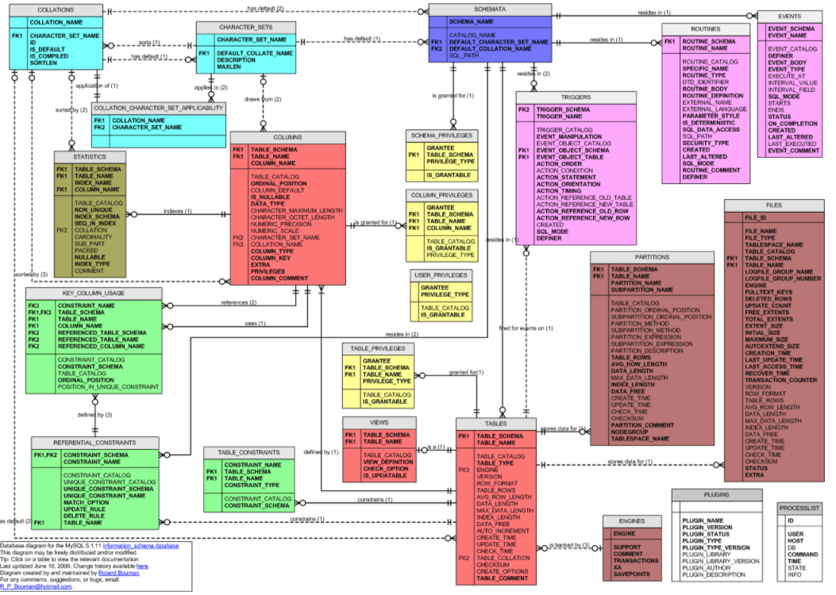
MySQL Catalog (Information_Schema)
Some of the MySQL Information Schema Tables:
'ADMINISTRABLE_ROLE_AUTHORIZATIONS'
'APPLICABLE_ROLES'
'CHARACTER_SETS'
'CHECK_CONSTRAINTS'
'COLUMN_PRIVILEGES'
'COLUMN_STATISTICS'
'COLUMNS'
'ENABLED_ROLES'
'ENGINES'
'EVENTS'
'FILES'
'KEY_COLUMN_USAGE'
'PARAMETERS'
'REFERENTIAL_CONSTRAINTS'
'RESOURCE_GROUPS'
'ROLE_COLUMN_GRANTS'
'ROLE_ROUTINE_GRANTS'
'ROLE_TABLE_GRANTS'
'ROUTINES'
'SCHEMA_PRIVILEGES'
'STATISTICS'
'TABLE_CONSTRAINTS'
'TABLE_PRIVILEGES'
'TABLES'
'TABLESPACES'
'TRIGGERS'
'USER_PRIVILEGES'
'VIEW_ROUTINE_USAGE'
'VIEW_TABLE_USAGE'
'VIEWS'
CREATE and ALTER statements modify the data.
DBMS reads information:
Parsing
Optimizer
etc.

Slide 67
Switch to Notebook

Slide 68
Rule 6: View Updating Rule
All the views of a database, which can theoretically be updated, must also be updatable by the system.
Introduction
68 | COMS W4111_002_2025_1 - Lecture 5: ER(4), Relational(4), SQL(4) © Donald F. Ferguson, 2025

Slide 69
Which can theoretically be updated
What are some examples of things that make a view no “updatable?”
Aggregate Functions
SQL INSERT, UPDATE and DELETE affect one row at a time.
Aggregate functions convert multiple rows into one row, which may invove sum, average, … on column values.
How would you map the update of an average to the individual, underlying rows?
The underlying table may have NOT NULL columns that are not in the view ➔ INSERT will not work.
The “project” can merge or transform columns in rows, e.g.
CREATE VIEW cool as SELECT concat(first_name, last_name) as full_name from person.
What would it mean to do an UPDATE on cool.full_name

Slide 70
Overview

Slide 71
Index Creation
Many queries reference only a small proportion of the records in a table.
It is inefficient for the system to read every record to find a record with particular value
An index on an attribute of a relation is a data structure that allows the database system to find those tuples in the relation that have a specified value for that attribute efficiently, without scanning through all the tuples of the relation.
We create an index with the create index command
create index <name> on <relation-name> (attribute);

Slide 72
Index Creation Example
create table student (ID varchar (5), name varchar (20) not null, dept_name varchar (20), tot_cred numeric (3,0) default 0, primary key (ID))
create index studentID_index on student(ID)
The query:
select * from student where ID = '12345'
can be executed by using the index to find the required record, without looking at all records of student
DFF:
An index on (column1, column2, column3)
Is also an index on (column1) and (column1, column2)
But not (column2), (column3), (column2, column3).
We will see “why” later in the semester.
Show performance in Notebook

Slide 73
Applications, REST, Data Engineering Project

Slide 74
REST and Web Applications

Slide 75
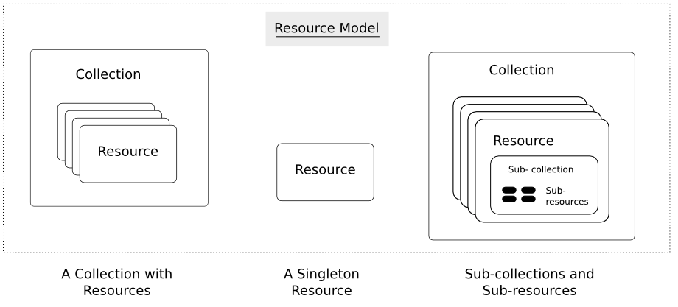
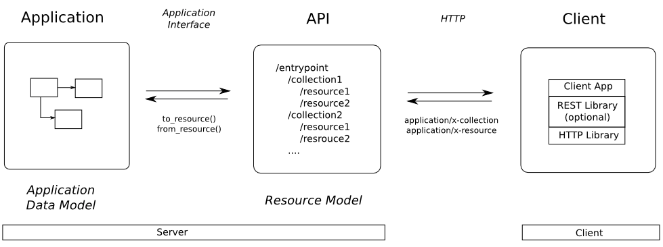
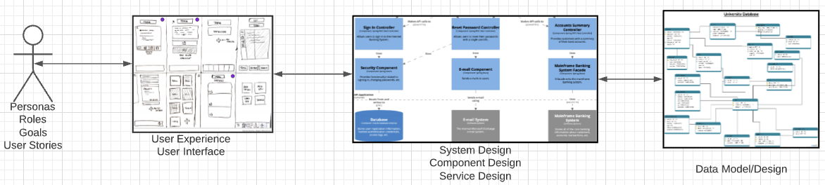
Web Application Problem Statement
We must build a system that supports create, retrieve, update and delete for IMDB and Game of Thrones Datasets.
This requires implementing create, retrieve, update and delete (CRUD) for resources.
We will design, develop, test and deploy the system iteratively and continuously.
There are four core domains.
https://restful-api-design.readthedocs.io/en/latest/resources.html
In this course,
We focus on the data dimension.
We will get some insight into the other dimensions.

Slide 76
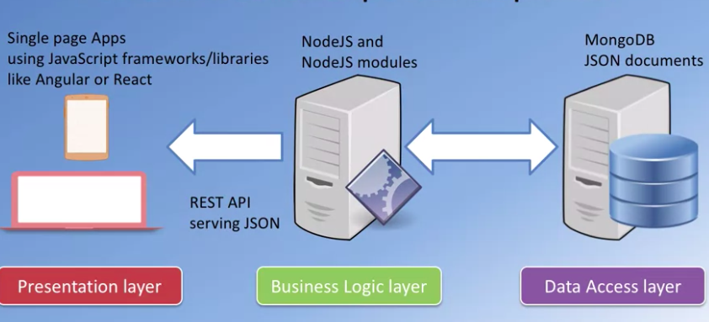
Interactive/Operational
“A full stack web developer is a person who can develop both client and server software. In addition to mastering HTML and CSS, he/she also knows how to:
Program a browser (like using JavaScript, jQuery, Angular, or Vue)
Program a server (like using PHP, ASP, Python, or Node)
Program a database (like using SQL, SQLite, or MongoDB)”
https://www.w3schools.com/whatis/whatis_fullstack.asp
We will do a simple full stack app.
Three databases:
MySQL
MongoDB
Neo4j
The application tier will be Python and FastAPI.
The web UI will be Angular.
The primary focus is the data layer and application layer that access it.
I will provide a simple UI and template.

Slide 77
Data Modeling Concepts and REST
Almost any data model has the same core concepts:
Types and instances:
Entity Type: A definition of a type of thing with properties and relationships.
Entity Instance: A specific instantiation of the Entity Type
Entity Set Instance: An Entity Type that:
Has properties and relationships like any entity, but ...
Has at least one special relationship – contains.
Operations, minimally CRUD, that manipulate entity types and instances:
Create
Retrieve
Update
Delete
Reference/Identify/... ...
Host/database/table/pk

Slide 78
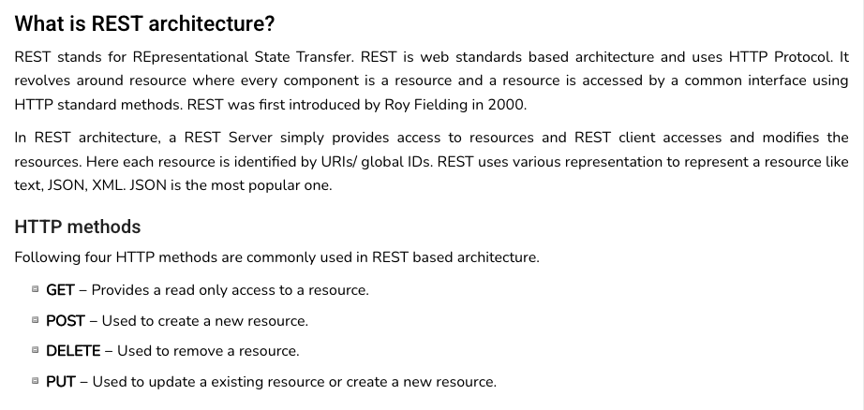
REST (https://www.tutorialspoint.com/restful/restful_introduction.htm)

Slide 79
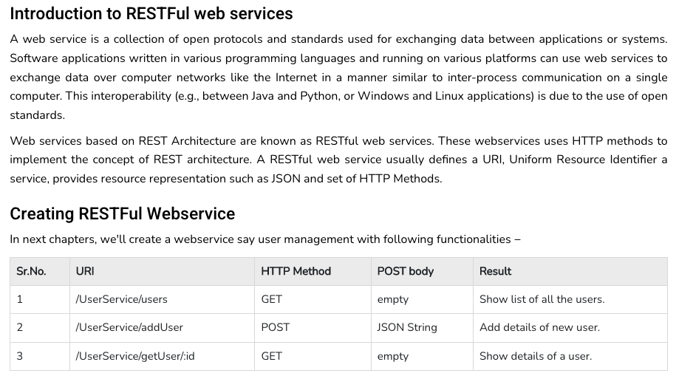
REST (https://www.tutorialspoint.com/restful/restful_introduction.htm)

Slide 80
REST and Resources

Slide 81
URLs

Slide 82
Code
/Users/donald.ferguson/Dropbox/000/000-A-Current-Examples/W4111-FastAPI-IMDB-Solution
/Users/donald.ferguson/Dropbox/000/000-A-Current-Examples/current-dashboard

